Slide 1

Face Mask Detection Based on Convolutional Neural Networks
TEAM MEMBERS: Guided By:
T Midhun Sai Reddy -224003061 Dr. S. Priyanga
S Vamsi Aakash -224003133 Assistant Professor-II
S P Lokesh Reddy -224003053 Srinivasa Ramanujan Center
Sastra Deemed to be University

Slide 2
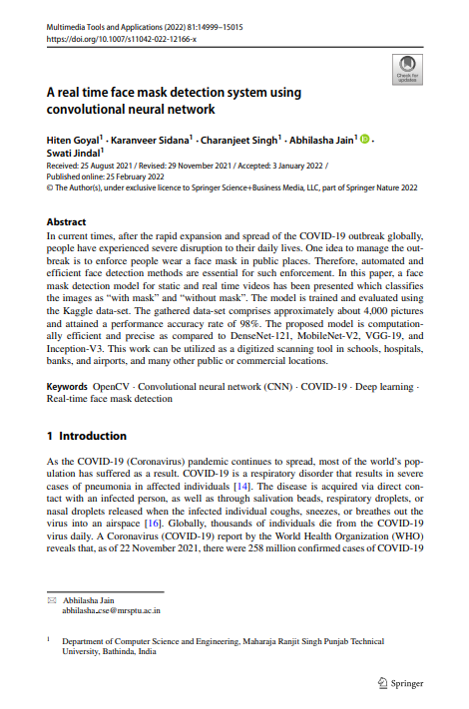
Base Paper

Slide 3
Problem Statement :
The COVID-19 pandemic has highlighted the importance of wearing face masks to prevent the spread of the virus, but ensuring compliance with mask-wearing mandates is a challenge
Manual monitoring of large crowds to detect non-compliance with mask-wearing rules is time-consuming and prone to errors, and requires a significant number of personnel
A face mask detection system based on convolutional neural networks (CNNs) can automate the process of monitoring and identifying individuals who are not wearing masks, enabling more efficient and accurate enforcement of mask-wearing rules

Slide 4
Requirements
SOFTWARE REQUIREMENTS :
➢ Software : Python IDLE(3.10.2)
➢ Programming Language : Python 3
➢ IDE : JupyterLab
HARDWARE REQUIREMENTS:
➢ Hard Disk drive : 128 GB
➢ RAM : 8 GB

Slide 5
Literature review
TITLE | Author | Journal / Year | Methodology | Drawbacks
Face Mask Detection Using Transfer Learning with VGG16 and InceptionV3 CNNs | Shafi et al. | Journal of Healthcare Engineering 2020 | Transfer learning with VGG16 and InceptionV3 CNNs | Limited dataset size and potential bias in image selection
A Multi-Task Convolutional Neural Network for Mask Detection and Object Classification | Li et al. | IEEE Access 2020 | Multi-task learning with object detection and classification CNNs | Limited dataset size and sensitivity to object size and position

Slide 6
TITLE | Author | Journal / Year | Methodology | Drawbacks
Real-time Face Mask Detection using YOLOv3 | Mehta et al. | International Journal of Advanced Computer Science and Applications 2020 | Object detection with YOLOv3 CNN | Limited dataset size and need for high computational power
Face Mask Detection and Tracking | Mahajan et al. | IEEE International Conference on Computational Intelligence and Computing Research 2020 | Object detection with YOLOv3 and deep SORT tracking algorithm | Limited dataset size and potential for tracking errors in crowded scenes

Slide 7
TITLE | Author | Journal / Year | Methdology | Drawbacks
Detection of Face Mask and Social Distance Violations in Real-time Videos | Goh et | IEEE Access | Object detection with Faster R-CNN CNN | Limited dataset size and potential for false positives in complex scenes

Slide 8
Objectives
To create a facemask detector in precisely detecting the presence of mask in a real-time using images and video streams
To develop the deep learning based classification approaches for distinguishing face mask and non-face mask classes

Slide 9
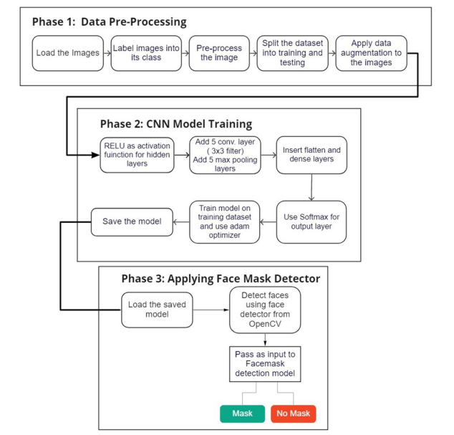
Proposed Architecture

Slide 10
Dataset
→The model is trained and evaluated using the Kaggle data-set. The gathered data-set comprises approximately about 4,000 pictures
→Each image in the dataset is labeled as either "with mask" or "without mask" to indicate whether the person in the image is wearing a face mask or not

Slide 11
Convolution Neural Network(CNN):-
CNN is distinguished from other neural networks by their superior performance with image, speech, or audio signal inputs. They have three main types of layers, which are:
→Convolutional layer
→Pooling layer
→Fully-connected (FC) layer
Convolutional layer:
The convolutional layer is the core building block of a CNN, and it is where the majority of computation occurs. We have a feature detector, also known as a kernel or a filter, which will move across the receptive fields of the image, checking if the feature is present. This process is known as a convolution.

Slide 12
Pooling Layer:
Pooling layers, also known as downsampling, conducts dimensionality reduction, reducing the number of parameters in the input. Similar to the convolutional layer, the pooling operation sweeps a filter across the entire input, but the difference is that this filter does not have any weights.
Max pooling: As the filter moves across the input, it selects the pixel with the maximum value to send to the output array.
Fully connected Layer:
In the fully-connected layer, each node in the output layer connects directly to a node in the previous layer.This layer performs the task of classification based on the features extracted through the previous layers and their different filters.

Slide 13
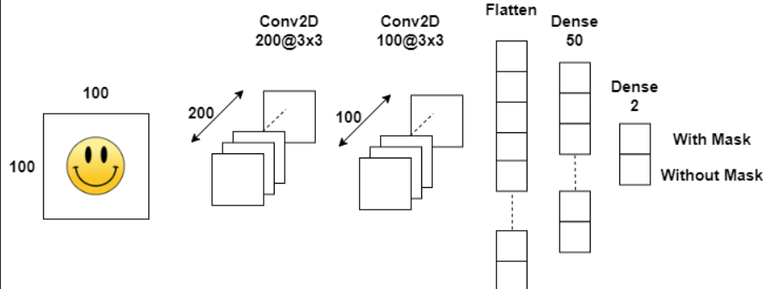
CNN Architecture

Slide 14
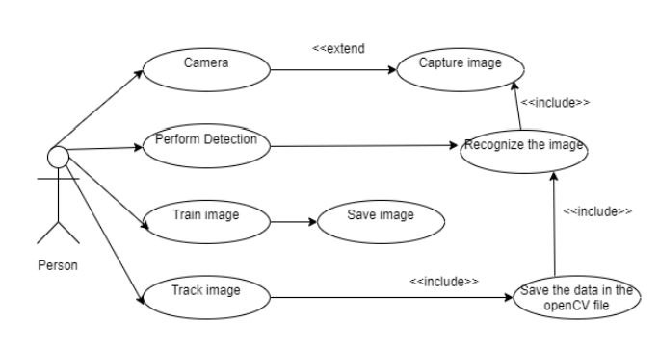
Use Case Diagram

Slide 15
Modules
Data Pre-Processing
Data Training
Detecting masks

Slide 16
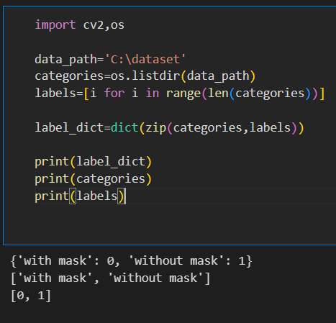
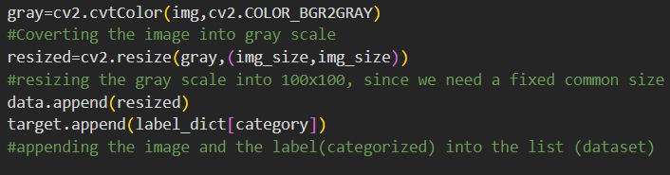
Data Pre-Processing
First we are going to import images from data set
for each image we are going to convert into grayscale , resizing in to 100*100 size and appending them in to data and target numpy arrays

Slide 17
Data Training
One of the most difficult task in our project.
we are able to complete only 10 epochs in 1/2 hrs. so we used to save the model for each epoch and load the recent saved model in new notebook and the process will continue.
Our model is not improving after 20 epochs. so we stopped training the model at that point.

Slide 18
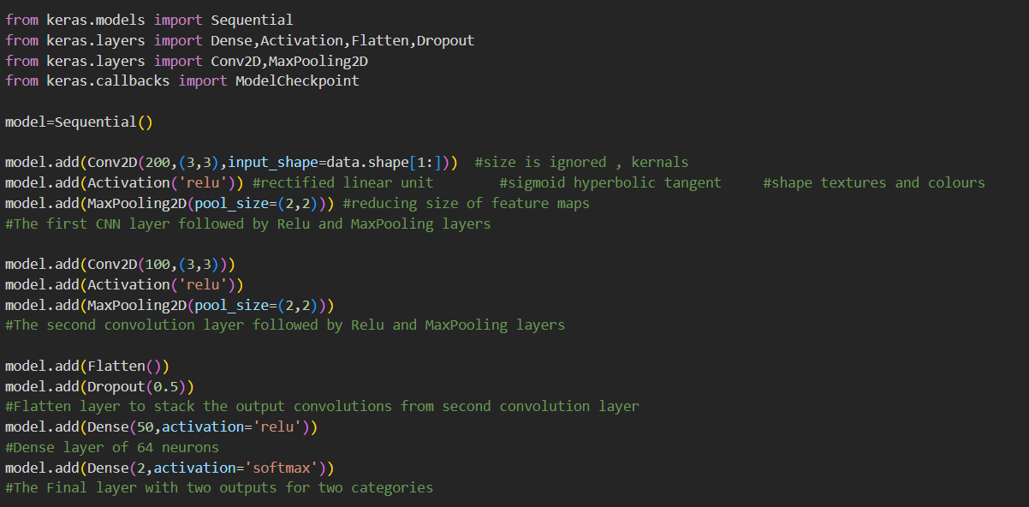

Slide 19
Why only ReLU
The full form of ReLU is rectified linear activation function
It has become the default activation function for many types of neural networks because a model that uses it is easier to train and often achieves better performance.
As we have many layers we should not use other functions like sigmoid, hyperbolic tangent, etc due to vanishing gradient problem.
The ReLU will overcome the vanishing gradient problem and allows the model to learn faster and good accuracy

Slide 20
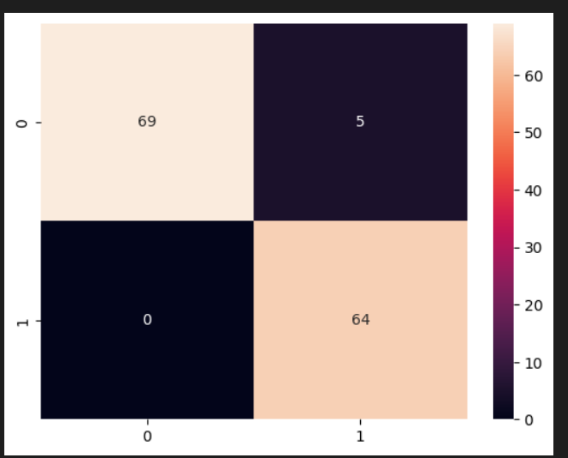
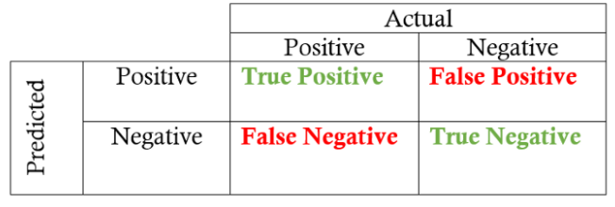
Confusion Matrix

Slide 21
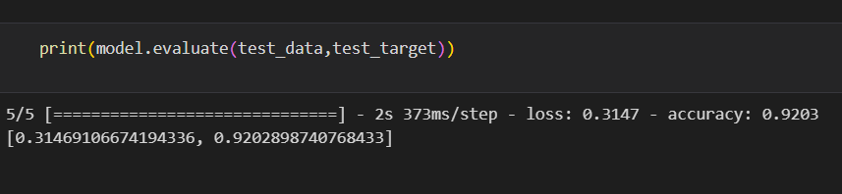
Accuracy of our model
5927 images are used for testing the model. The accuracy of the model is 80.1%
4000 images are used for testing the model. The accuracy of the model is 92.02%

Slide 22
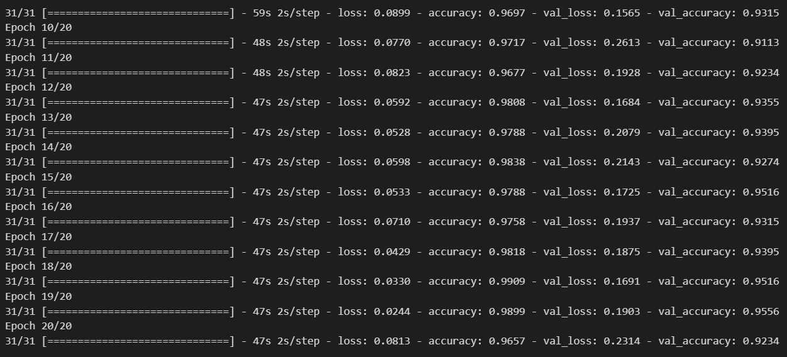
Accuracy and loss

Slide 23
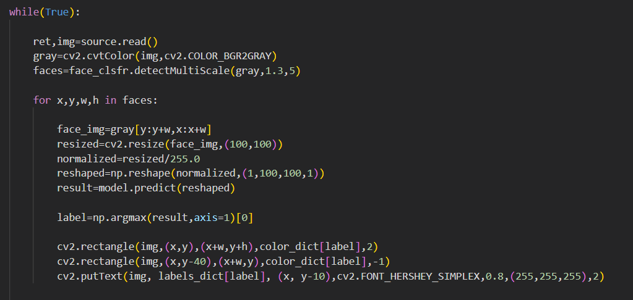
Detecting Masks
Load saved model in training
capture real time images using open cv module
capture image preprocess it and use modle to predict output

Slide 24
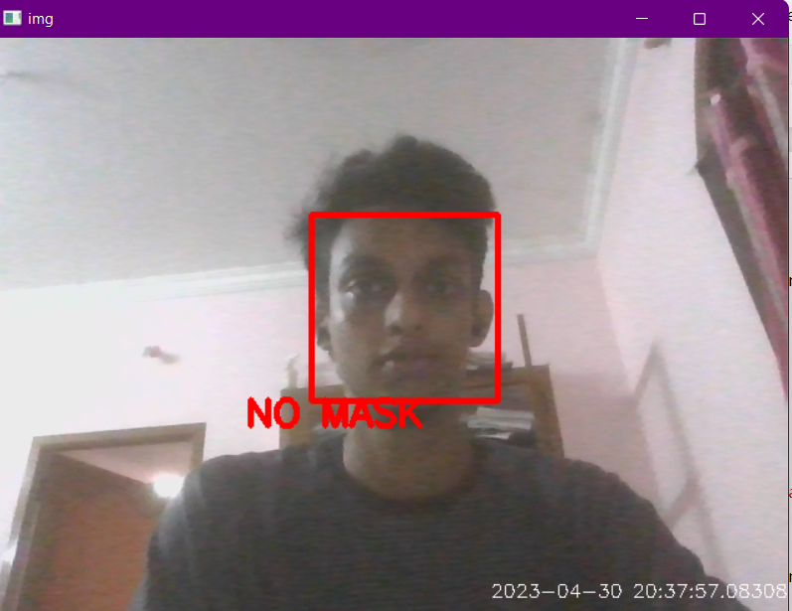
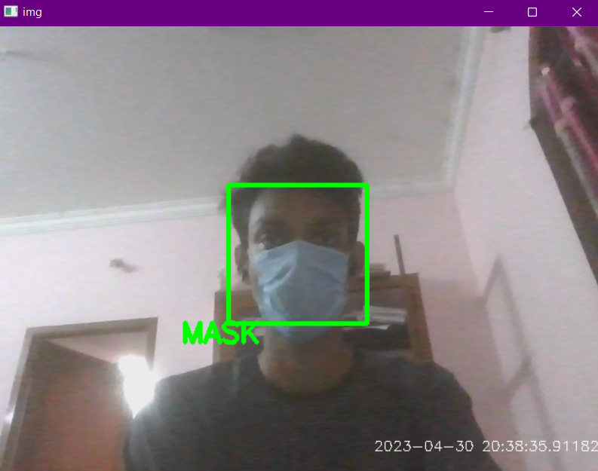
Output

Slide 25
Work Plan
Time period | Work allotted | Expected outcome
February | Data preprocessing | The process of transforming raw data into meaningful output i.e. information.
March | Data Training | he general outcome of data training is to create a model that can make accurate predictions or classifications on new, unseen data.
April | Identifying masks | Showing mask or no mask on screen
May | Prepare Reports | --

Slide 26
Conclusion
Thus face Mask detection model was build using convolution neural networks.
The face detection is done by haarcascade_frontalface to extract the locations of multiple faces in a image.
By using 40000 images for training and testing , the model acquired an accuracy of % with a loss of 1.1811.

Slide 27
References
[1] Patel, Vatsa S., et al. "Masked face analysis via multi-task deep learning." Journal of Imaging 7.10 (2021): 204. [2] Vinh, Truong Quang, and Nguyen Tran Ngoc Anh. "Real-time face mask detector using YOLOv3 algorithm and Haar cascade classifier." 2020 international conference on advanced computing and applications (ACOMP). IEEE, 2020. [3] Kaur, Gagandeep, et al. "Face mask recognition system using CNN model." Neuroscience Informatics 2.3 (2022): 100035. [4] Sharan, E. Sai, Kodali Sudheer Kumar, and Gourabathina Madhuri. "Conceal face mask recognition using convolutional neural networks." 2021 6th International Conference on Communication and Electronics Systems (ICCES). IEEE, 2021. [5] Chavda, Amit, et al. "Multi-stage CNN architecture for face mask detection." 2021 6th International Conference for Convergence in Technology (i2ct). IEEE, 2021.

Slide 28
THANK YOU

